Slide 1
In collaboration with
Morden Islamic Community Centre
For Wimbledon and Morden

Slide 2
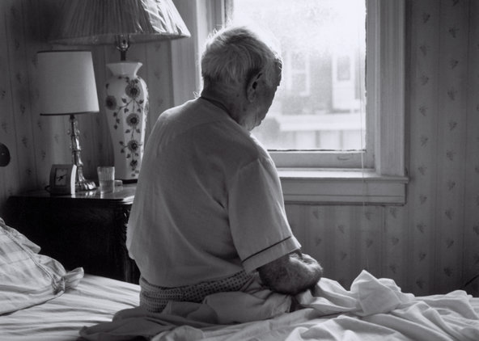
THE NEED FOR THE ESAAR PROJECT:
We belong to a deen that gives priority in serving the elderly first in everything. Whether it be in prayer, food, drink, place to sit or in saying Salam. It was narrated that the Prophet (peace and blessings be upon him) said, “Jibreel ordered me to give priority to the elderly.”
Sadly, to keep pace with the challenges of the Modern lifestyle, many in our Muslim community have abandoned or neglected the care of their elders. Some elders are also left alone due to death of spouse, friends, and other natural circumstances
Many of our house bound Muslim elders have been left in loneliness, entirely dependent on the Social Care system of the country, which is already crippling under shortages of staff and funds. We all have personally come across stories of elderly seniors, living alone and house bound for final years of their lives, only to be found at the time of their death. Although this problem has surpassed from being a first world problem, our responsibility lies with those in our neighbourhood first. We want to fulfil this communal responsibility with the help from the local Muslim community and ensure that our honourable elders do not suffer in silence.

Slide 3
OUR PLAN:
We intend to launch a program that would pair a Lonely and Housebound Elderly Muslim (LHEM) with a volunteer that lives closest to them in distance.
This will be done by collating a list of the LHEM in our community (with their permission) through advertisement and outreach.
We will then run a volunteer recruitment drive and enlist their contact details.
Those on the list of volunteers will be invited to an open day.
The Esaar Project will be discussed in detail and volunteers will be interviewed.
Further interviewing and vetting process will be done.
DBS registration will begin.
The lists of LHEM and volunteers will be put into a database that will connect
them based on proximity of location.
Initial training session will be run for the volunteers with Team Esaar and other external training
with Age UK Merton and other organisations.
The volunteers will start contact with their assigned LHEM.

Slide 4
Anas ibn Malik (may Allah be pleased with him) narrated that the Prophet (peace and blessings be upon him) said, “If a young man honors an elderly on account of his age, Allah appoints someone to honor him in his old age.” (At-Tirmidhi; ranked hasan by Al-Albani)

Slide 5
Step by Step Volunteering Process
Liaise with assigned key worker about progress
Assess the needs and requirements of the Elderly
Volunteer & Elderly introduced
Pair with the elderly
Enter the database
Dbs. Checks
Interview
Fill in the form

Slide 6
What will Volunteers get?
Honour in old age by Allah.
A Job Reference from Esaar Team.
Training and support from Esaar Project Team.
Regular meetups and team building days with other volunteers at Esaar Project.
To Volunteer as Befriender please watsapp or call:
Zainab Sheikh 07853138619 OR Yasmin Choudhury 07961055785

Slide 7
Elderly Signup Process
The Elderly or their friends or family make contact with us.
Esaar team meets them, analyses their need and put their details in the data base.
A trained volunteer who lives in the closest proximity to their house is assigned to them.
An initial assessment is made on their needs with the assigned volunteer i.e., befriending
call, weekly shopping assistance, weekly check in etc.
If they need help with cleaning, a volunteer or paid help can
be arranged for them.
A plan is drafted by the Esaar team, the volunteer and the elderly and
contact is inniated by the volunteer.
The volunteer updates the Esaar project team about the scheduled visits.
Esaar Team also remains in touch with the Elderly.
If you would like an Elderly to sign up
please call or Watsapp: Maryam Kathoria +44 7519 647023

Slide 8
Signing up Elderly, Lonely and Housebound Muslim
Families
Friends
Neighbours
Masjid
Library
Social media
Gp Surgeries
Pharmacies
Care Agencies

Slide 9
Data Protection
No information will be shared with any other party.
The volunteers will be trained to hold the information as an Amanah and not share any details of their contact with others.

Slide 10
What we need from other Masajid
1. InshaAllah, Esaar project will continue to collaborate with other Masajid on the model of its collaboration with Morden Islamic Community Centre.
2. InshaAllah, in the future a user-friendly database template could be made available in a downloadable format to community leaders wanting to start Esaar Project at their masjid.
3. InshaAllah, Esaar App can also be developed to manage contact between the LHEM and the recruited volunteers.

Slide 11
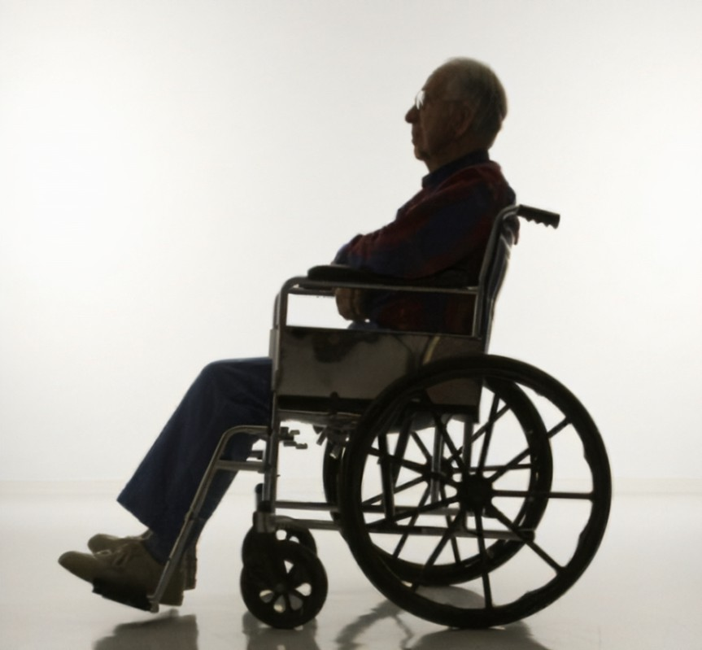
Future Plans;
To facilitate the House bound and lonely elderly Muslims to come to the coffee morning at Morden Islamic Community Centre.
Exercise sessions.
Arrange picnics and trips.
Facilitate Counselling sessions.

